Slide 1

CSC/CPE 138 - Computer Network Fundamentals
Transport Layer
The presentation was adapted from the textbook: Computer Networking: A Top-Down Approach 8th edition Jim Kurose, Keith Ross, Pearson, 2020

Slide 2
Connection-oriented demultiplexing (TCP)
TCP socket identified by 4-tuple:
source IP address
source port number
dest IP address
dest port number
server may support many simultaneous TCP sockets:
each socket identified by its own 4-tuple
each socket associated with a different connecting client
demux: receiver uses all four values (4-tuple) to direct segment to appropriate socket

Slide 3


Connection-oriented demultiplexing: example
application
application
P4
P5
P6
application
P1
P2
P3
transport
transport
network
transport
network
link
network
link
physical
link
physical
server: IP address B
physical
host: IP address A
source IP,port: B,80
dest IP,port: A,9157
host: IP address C
source IP,port: C,5775
dest IP,port: B,80
source IP,port: A,9157
dest IP, port: B,80
source IP,port: C,9157
dest IP,port: B,80
Three segments, all destined to IP address: B,
dest port: 80 are demultiplexed to different sockets

Slide 4
Summary
Multiplexing, demultiplexing: based on segment, datagram header field values
UDP: demultiplexing using destination port number (only)
TCP: demultiplexing using 4-tuple: source and destination IP addresses, and port numbers
Multiplexing/demultiplexing happen at all layers

Slide 5

Chapter 3: roadmap
Transport-layer services
Multiplexing and demultiplexing
Connectionless transport: UDP
Principles of reliable data transfer
Connection-oriented transport: TCP
Principles of congestion control
TCP congestion control
Evolution of transport-layer functionality

Slide 6
UDP: User Datagram Protocol
Why is there a UDP?
“no frills,” “bare bones” Internet transport protocol
“best effort” service, UDP segments may be:
lost
delivered out-of-order to app
no connection establishment (which can add RTT delay)
simple: no connection state at sender, receiver
small header size
no congestion control
UDP can blast away as fast as desired!
can function in the face of congestion
connectionless:
no handshaking between UDP sender, receiver
each UDP segment handled independently of others

Slide 7
UDP: User Datagram Protocol
UDP use:
streaming multimedia apps (loss tolerant, rate sensitive)
DNS
SNMP
HTTP/3
if reliable transfer needed over UDP (e.g., HTTP/3):
add needed reliability at application layer
add congestion control at application layer

Slide 8
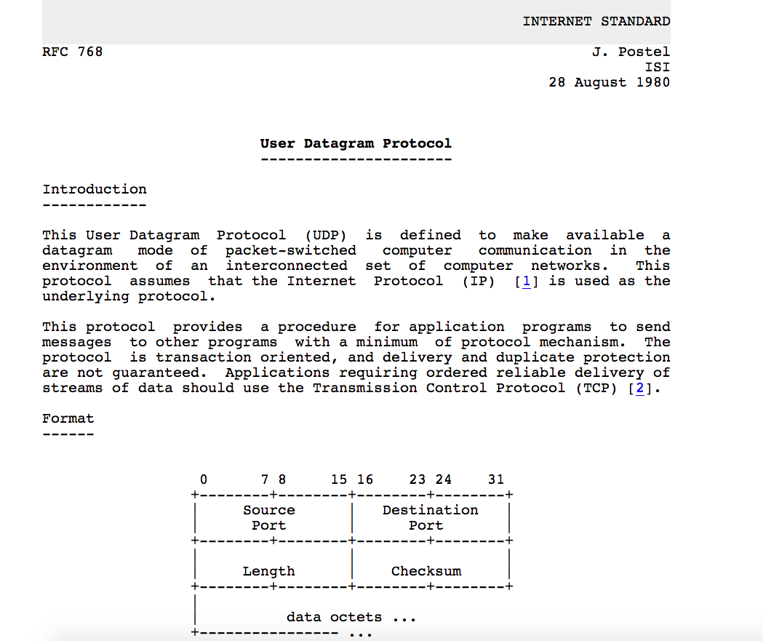
UDP: User Datagram Protocol [RFC 768]
Notes:
read this RFC – it’s only 2.5 pages!

Slide 9
UDP: Transport Layer Actions
SNMP client
SNMP server
application
application
transport
(UDP)
transport
(UDP)
network (IP)
network (IP)
link
link
physical
physical

Slide 10
UDP: Transport Layer Actions
SNMP client
SNMP server
UDP sender actions:
application
application
is passed an application-layer message
SNMP msg
transport
(UDP)
transport
(UDP)
determines UDP segment header fields values
UDP_{h}
SNMP msg
UDP_{h}
creates UDP segment
network (IP)
network (IP)
passes segment to IP
link
link
physical
physical

Slide 11
UDP: Transport Layer Actions
SNMP client
SNMP server
UDP receiver actions:
application
receives segment from IP
application
checks UDP checksum header value
transport
(UDP)
transport
(UDP)
SNMP msg
extracts application-layer message
network (IP)
network (IP)
SNMP msg
UDP_{h}
demultiplexes message up to application via socket
link
link
physical
physical

Slide 12
UDP segment header
32 bits
source port #
dest port #
length
checksum
application
data
(payload)
length, in bytes of UDP segment, including header
data to/from application layer
UDP segment format

Slide 13

UDP checksum
Goal: detect errors (i.e., flipped bits) in transmitted segment
1st number
2nd number
sum
Transmitted: 5 6 11
Received: 4 6 11
receiver-computed
checksum
=
sender-computed
checksum (as received)

Slide 14
Internet checksum
Goal: detect errors (i.e., flipped bits) in transmitted segment
sender:
treat contents of UDP segment (including UDP header fields and IP addresses) as sequence of 16-bit integers
checksum: addition (one’s complement sum) of segment content
checksum value put into UDP checksum field
receiver:
compute checksum of received segment
check if computed checksum equals checksum field value:
not equal - error detected
equal - no error detected. But maybe errors nonetheless? More later ….

Slide 15
Internet checksum: an example
example: add two 16-bit integers
1 1 1 0 0 1 1 0 0 1 1 0 0 1 1 0
1 1 0 1 0 1 0 1 0 1 0 1 0 1 0 1
wraparound
1 1 0 1 1 1 0 1 1 1 0 1 1 1 0 1 1
sum
1 0 1 1 1 0 1 1 1 0 1 1 1 1 0 0
checksum
0 1 0 0 0 1 0 0 0 1 0 0 0 0 1 1
Note: when adding numbers, a carryout from the most significant bit needs to be added to the result

Slide 16
Internet checksum: weak protection!
example: add two 16-bit integers
0 1
1 1 1 0 0 1 1 0 0 1 1 0 0 1 1 0
1 0
1 1 0 1 0 1 0 1 0 1 0 1 0 1 0 1
wraparound
1 1 0 1 1 1 0 1 1 1 0 1 1 1 0 1 1
Even though numbers have changed (bit flips), no change in checksum!
sum
1 0 1 1 1 0 1 1 1 0 1 1 1 1 0 0
checksum
0 1 0 0 0 1 0 0 0 1 0 0 0 0 1 1

Slide 17
Summary: UDP
“no frills” protocol:
segments may be lost, delivered out of order
best effort service: “send and hope for the best”
UDP has its plusses:
no setup/handshaking needed (no RTT incurred)
can function when network service is compromised
helps with reliability (checksum)
build additional functionality on top of UDP in application layer (e.g., HTTP/3)

Slide 18
Chapter 3: roadmap
Transport-layer services
Multiplexing and demultiplexing
Connectionless transport: UDP
Principles of reliable data transfer
Connection-oriented transport: TCP
Principles of congestion control
TCP congestion control
Evolution of transport-layer functionality

Slide 19
Principles of reliable data transfer
sending process
receiving process
application
data
data
transport
reliable channel
reliable service abstraction
Notes:
note arrows through reliable data transfer channel is just one way – reliably send from sender to receiver

Slide 20
Principles of reliable data transfer
sending process
receiving process
sending process
receiving process
application
data
data
application
data
data
transport
transport
reliable channel
sender-side of
reliable data transfer protocol
receiver-side
of reliable data transfer protocol
reliable service abstraction
transport
network
unreliable channel
reliable service implementation
Notes:
Spend some time talking about how its to the sender and receiver side protocol that IMPLEMENTS reliable data transfer
Communication over unreliable channel is TWO-way: sender and receiver will exchange messages back and forth to IMPLEMENT one-way reliable data transfer

Slide 21
Principles of reliable data transfer
sending process
receiving process
application
data
data
transport
sender-side of
reliable data transfer protocol
receiver-side
of reliable data transfer protocol
Complexity of reliable data transfer protocol will depend (strongly) on characteristics of unreliable channel (lose, corrupt, reorder data?)
transport
network
unreliable channel
reliable service implementation
Notes:
So we have a sender side and a receiver side. How much work they’ll have to do depends on the IMPAIRMENTS introduced by channel – if the channel is perfect – no problem!

Slide 22

Principles of reliable data transfer
sending process
receiving process
application
data
data
transport
sender-side of
reliable data transfer protocol
receiver-side
of reliable data transfer protocol
Sender, receiver do not know the “state” of each other, e.g., was a message received?
unless communicated via a message
transport
network
unreliable channel
reliable service implementation
Notes:
Here’s a point of view to keep in mind – it’s easy for US to look at sender and receiver together and see what is happening. OH – that message sent was lost.
But think about it say from senders POV How does the sender know if its transmitted message over the unreliable channel got though?? ONLY if receiver somehow signals to the sender that it was received.
The key point here is that one side does NOT know what is going on at the other side – it’s as if there’s a curtain between them. Everything they know about the other can ONLY be learned by sending/receiving messages.
Sender process wants to make sure a segment got through. But it can just somehow magically look through curtain to see if receiver got it. It will be up to the receiver to let the sender KNOW that it (the receiver) has correctly received the segment.
How will the sender and receiver do that – that’s the PROTOCOL.
Before starting to develop a protocol, let’s look more closely at the interface (the API if you will)

Slide 23
Reliable data transfer protocol (rdt): interfaces
rdt_send(): called from above, (e.g., by app.). Passed data to deliver to receiver upper layer
deliver_data(): called by rdt to deliver data to upper layer
sending process
receiving process
rdt_send()
data
data
deliver_data()
data
sender-side
implementation of rdt reliable data transfer protocol
receiver-side
implementation of rdt reliable data transfer protocol
packet
udt_send()
Header
data
Header
data
rdt_rcv()
unreliable channel
udt_send(): called by rdt
to transfer packet over
unreliable channel to receiver
rdt_rcv(): called when packet arrives on receiver side of channel
Bi-directional communication over unreliable channel

